Slide 1
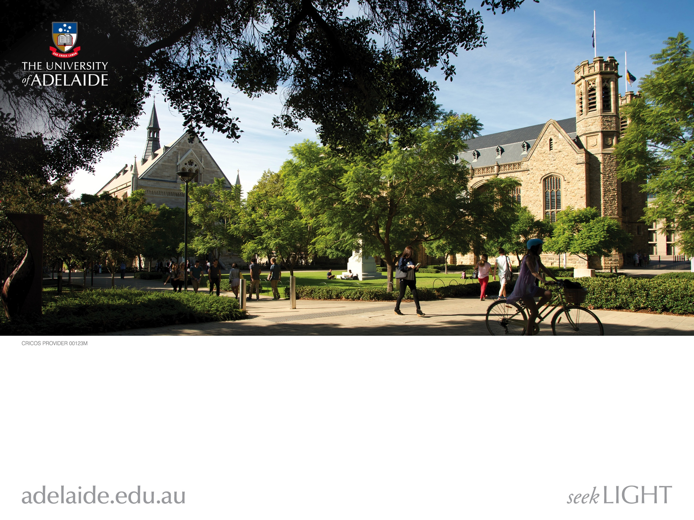
Course: Search-Based Software Engineering
General Information

Slide 2
This course is special.
Why?

Slide 3

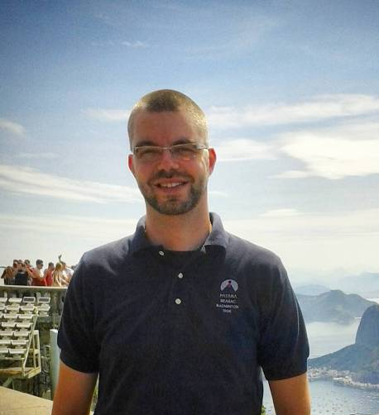
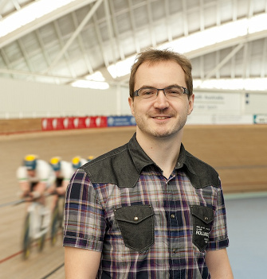
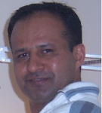
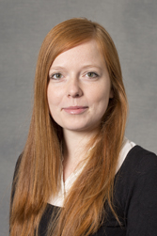
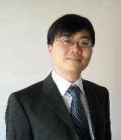
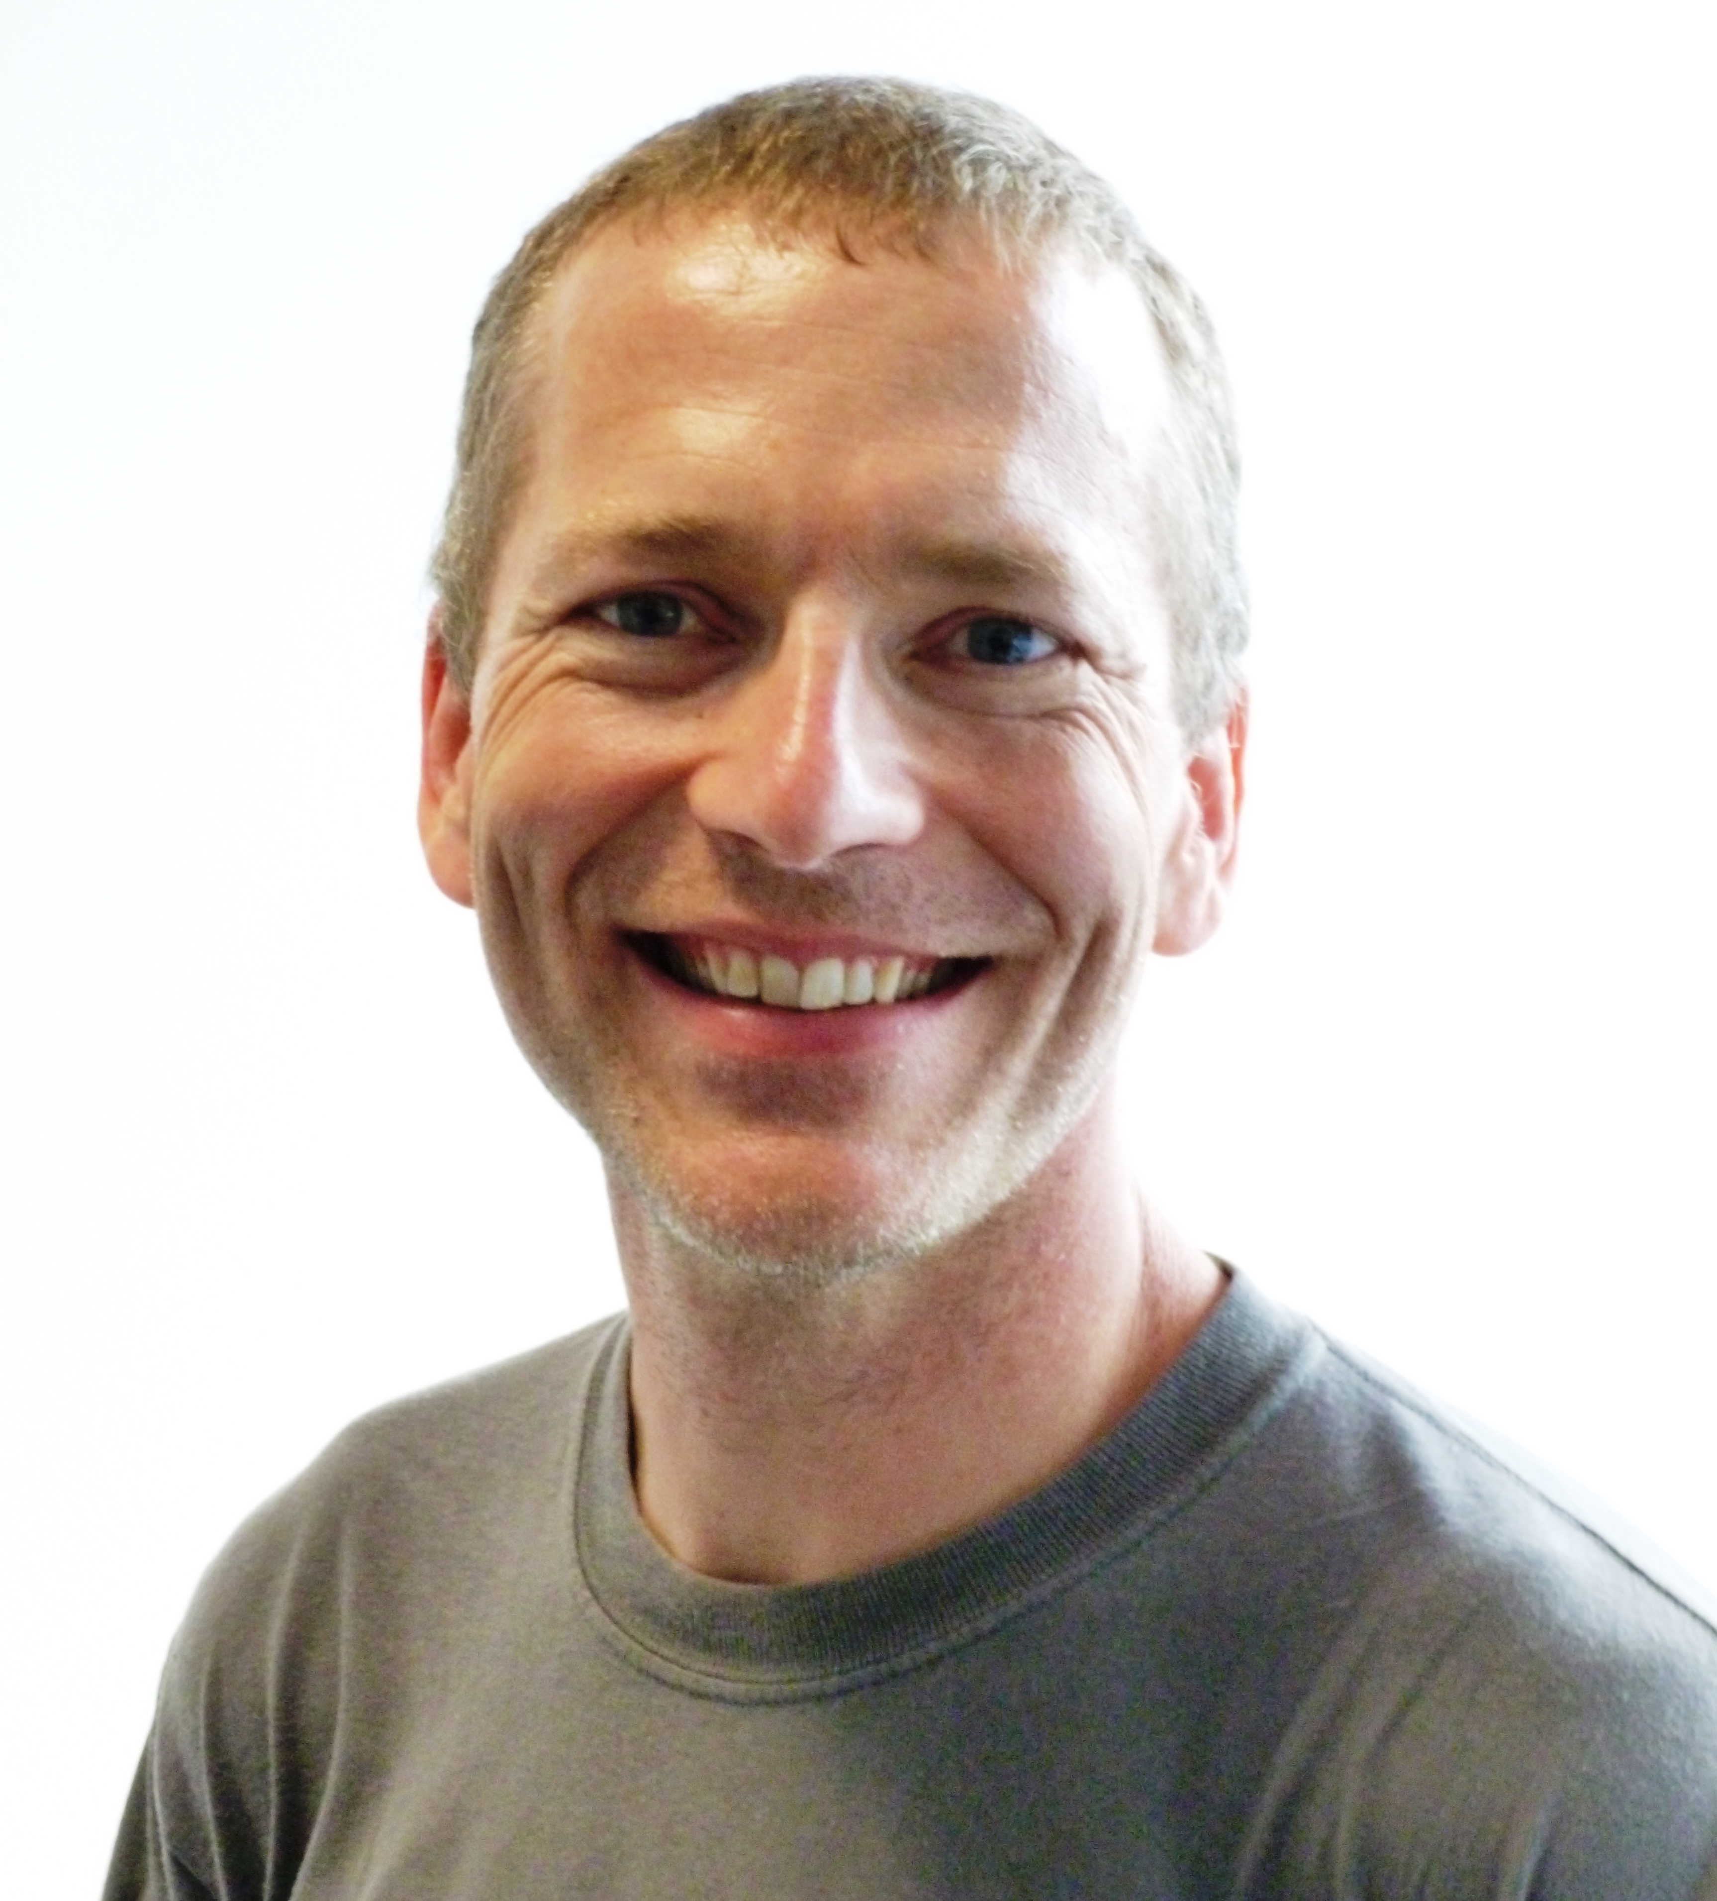
Reason 1/2: Lecturers
Earl and Justyna: from University College London
Afternoon/Evening lectures via Skype!

Slide 4
Reason 1/2: Lecturers
Bug fixing
Optimisation in general and UoA projects
Mining software repositories
Software product lines
Combinatorial interaction testing
Bounty hunting
Automatic software transplantation
Earl and Justyna: from University College London
Afternoon/Evening lectures via Skype!

Slide 5
Reason 2/2: Content
Many activities in software engineering involve an element of search.
Some examples include selection of requirements, localisation and correction of defects, and the optimisation of test coverage.
The fast-growing field of Search-Based Software Engineering (SBSE) applies computing resources to these search problems to improve the efficiency and quality of software engineering processes.
This course aims to introduce you to a wide range of SBSE terminology, techniques, and processes.
Assessment: group work + spotlight talks + essays (with feedback from us)

Slide 6
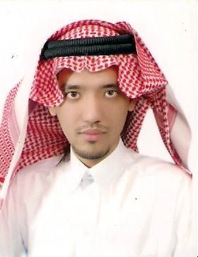
Main Staff
Christoph
(spotlight talks and essays)
Markus (course coordinator)
Mahmoud
(assignments)

Slide 7
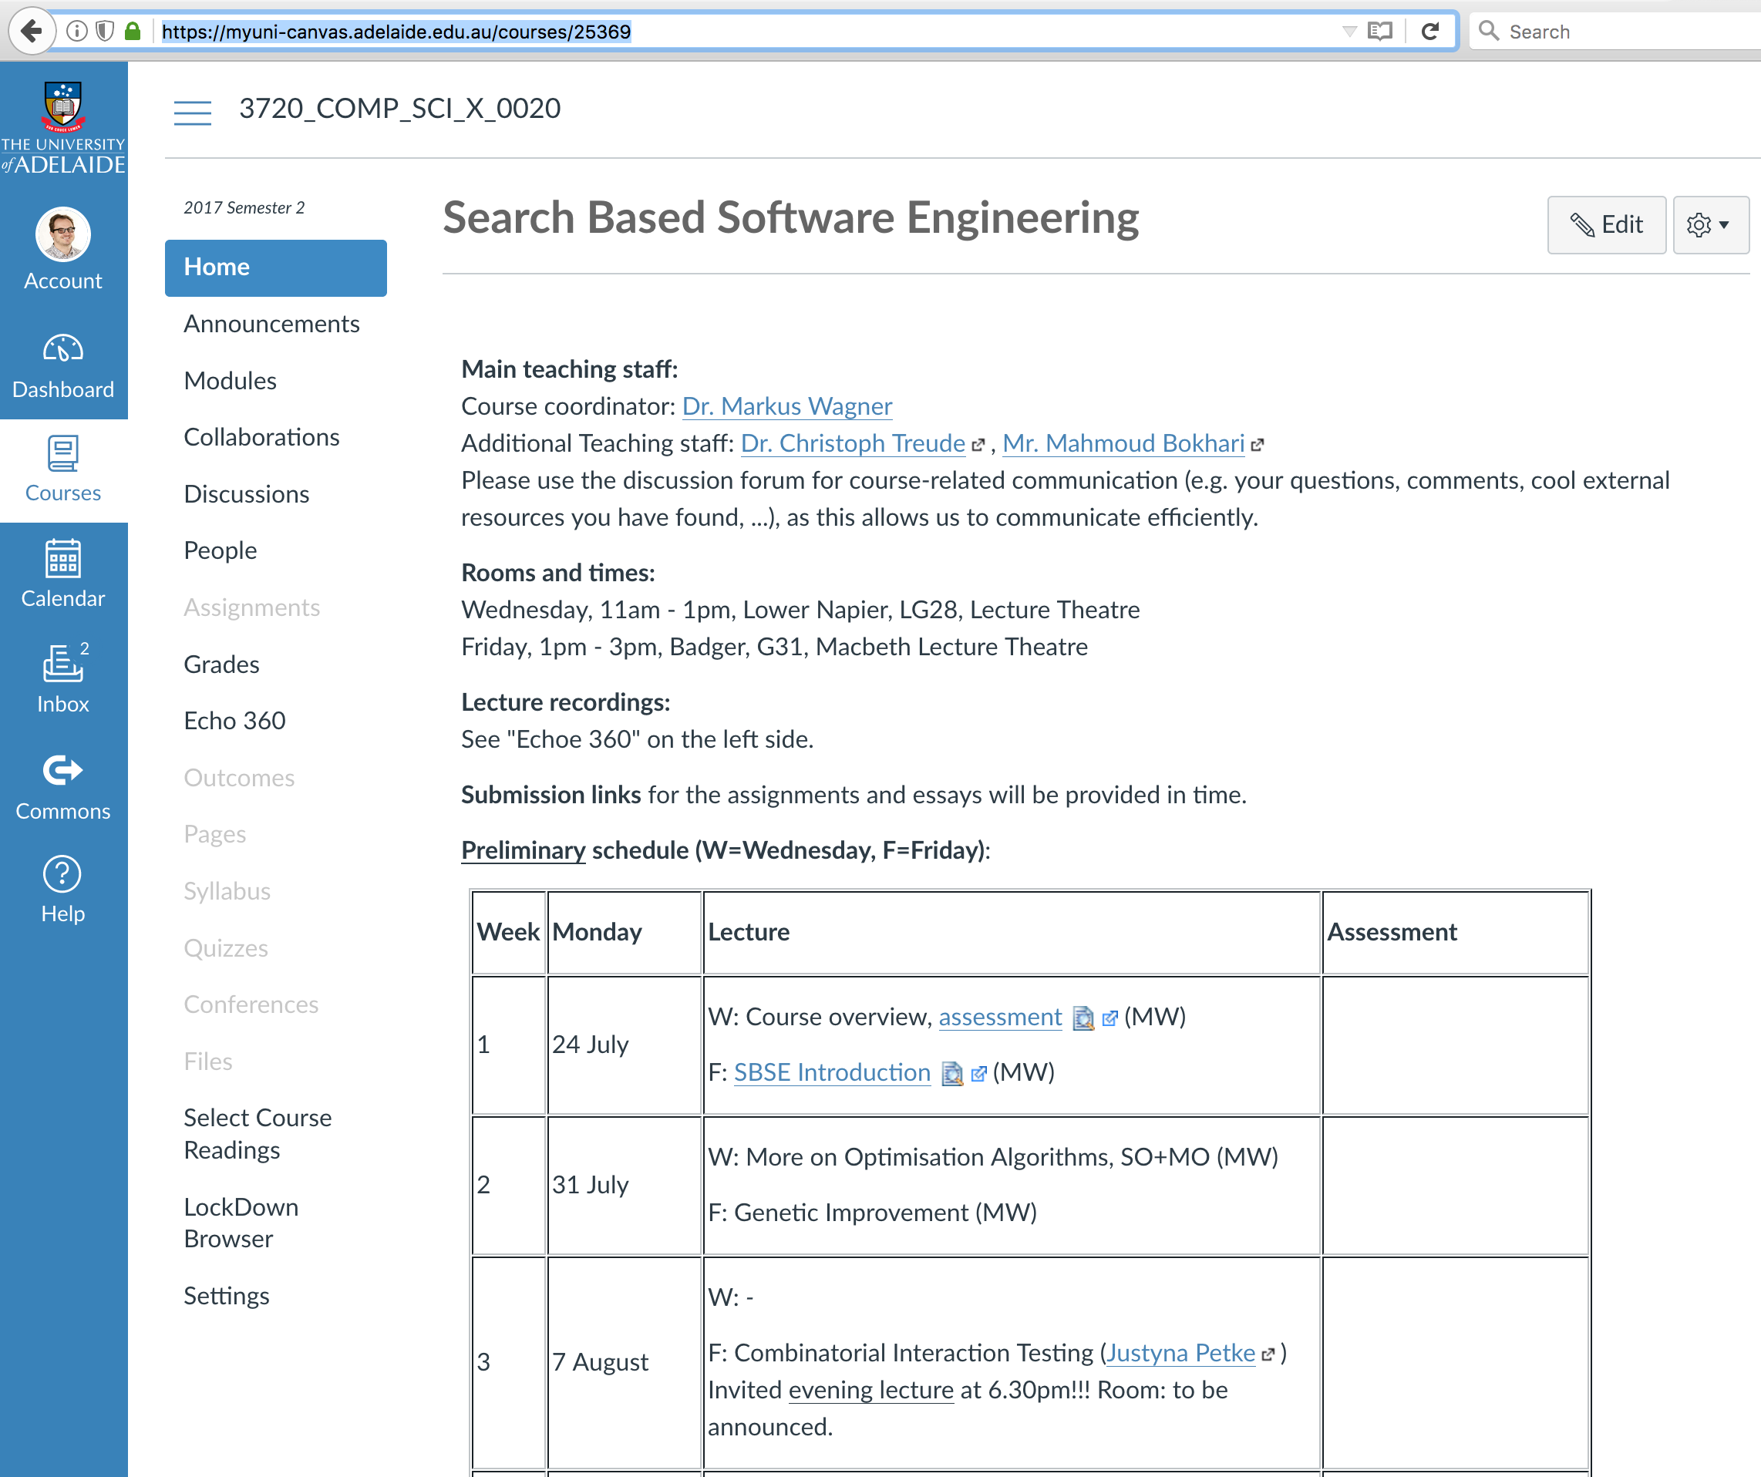
Course Website
https://myuni-canvas.adelaide.edu.au/courses/25369

Slide 8
This is all for today.
The first proper lecture will be on Friday, 28 July 2017.

